Slide 1
Openflow App Testing
Chao SHI,
Stephen Duraski

Slide 2
Motivation
Network is still a complex stuff !
Distributed mechanism
Complex protocol
Large state
Asynchronous events, random ordering, race conditions.

Slide 3
Motivation
Openflow does not reduce complexity, it just encapsulates it.
The distributed and asynchronous feature of networking is inherent
The correctness of controller not verified
Hard to test your apps on Openflow controller

Slide 4
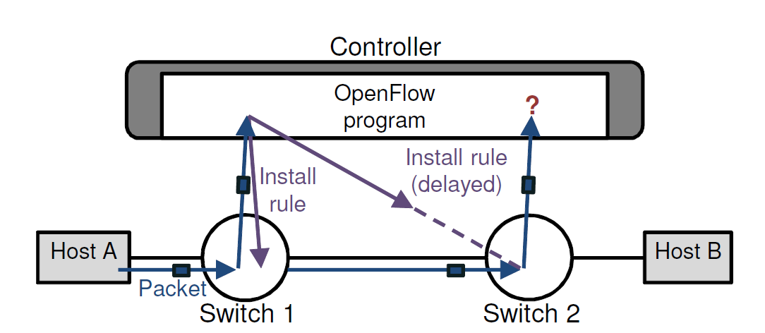
Race Condition

Slide 5
Background

Slide 6
Finite State Machine
A model of hardware or computer programs
State
Variable value assignment, flags, code block in execution, etc
Transition
Input (Event)
Output (Action)

Slide 7
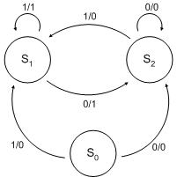
State Diagram

Slide 8
Model Checking for Distributed System
System:
Components & Channels
State:
Component State
System State = Component States + Channel Contents
Transition
Enabled Transitions (System level)
System Execution (Sequence of Transitions)
Notes:
CS: Variable value setting

Slide 9
Model Checking
What to look for:
Deadlocks, incompatible states causing crash
Both hardware and software
Method:
State Space Enumeration
Depth First Search using stack in the paper
No Scalability
Less suitable for software
Large possibility of user input
"Undecidability cannot be fully algorithmic"

Slide 10
Symbolic Execution
Tracking the symbolic variable rather than actual value
Symbolic variable is associated with input
Real variables are associated with symbolic variables and the expression is updated accordingly
Fork at every branch.
Still not scalable

Slide 11
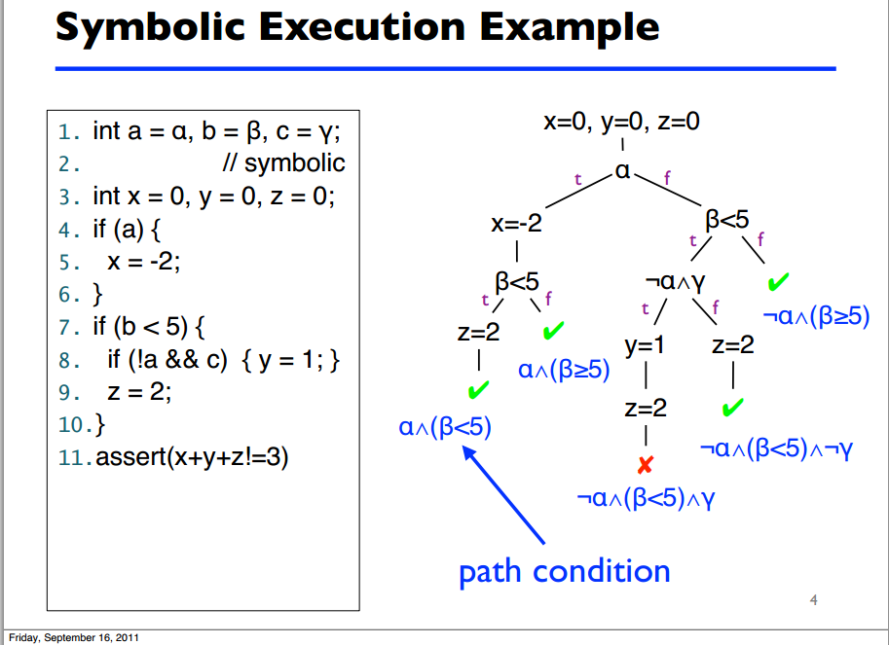
Notes:
Problem of this: (1) Finite code path :countable
(2) Input value does not change x, y, z
(3) Actually another branch for x + y + z !=3

Slide 12
Symbolic Execution
Equivalent class
Same code path for all instances in the same class
Still problems
Code path coverage does not mean system path coverage
Combine State Modeling and Symbolic Execution is good !
State modeling to exhaust system states
Symbolic execution to reduce transition numbers
Notes:
Symbolic execution does not encapsulate state

Slide 13
Design

Slide 14
Modeling in Openflow
State: Controller + Switch + Host
Transition
Input:
Event (Packet_IN, Flow_Removed, Port_Status)
Message Content (OFMessage) ( We don't want it )
Output:
The actual code path of the event Handler (Atomic)
That problem can be solved using the extension of Symbolic Execution
Notes:
Output is undetermined, based on input. The handler should be always the same based on events

Slide 15
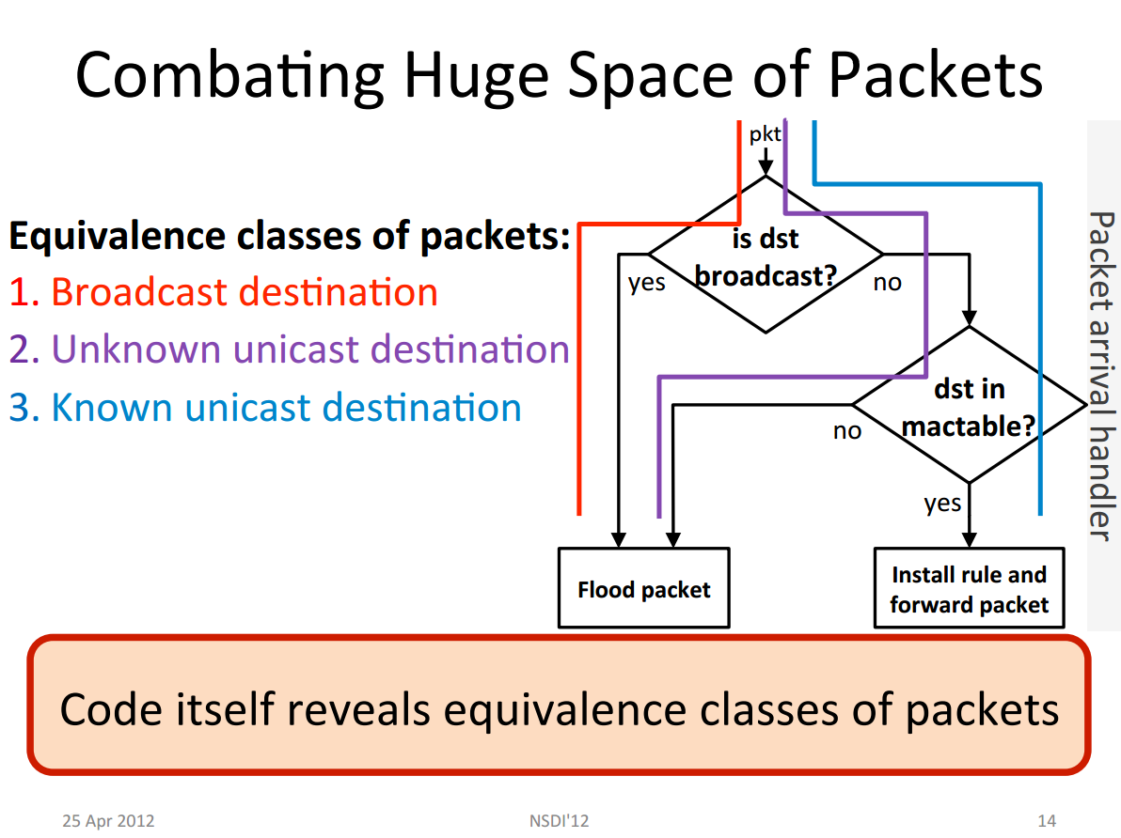

Slide 16
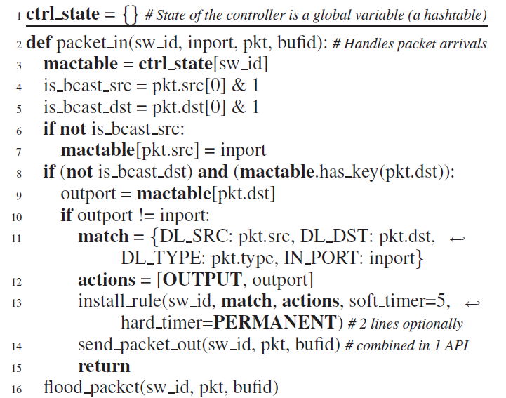

Slide 17
OFSwitch and Host Simplification
Switch is channels + flow table
Switch has Two simple transition
process_pkt, process_of
process_pkt: multiple packet processing - > a state transfer
Equivalent flow table is the same state
Host is categorized
Server-- receive / send_reply
Client -- send / receive
Notes:
host : limited transitions

Slide 18
Symbolic Execution
Find the equivalent class of input packet
Pick one packet from the class as relevant packet
Symbolic packet composed of Symbolic variables
Concrete Controller State
Notes:
Symbolic variables are part of symbolic packet header

Slide 19
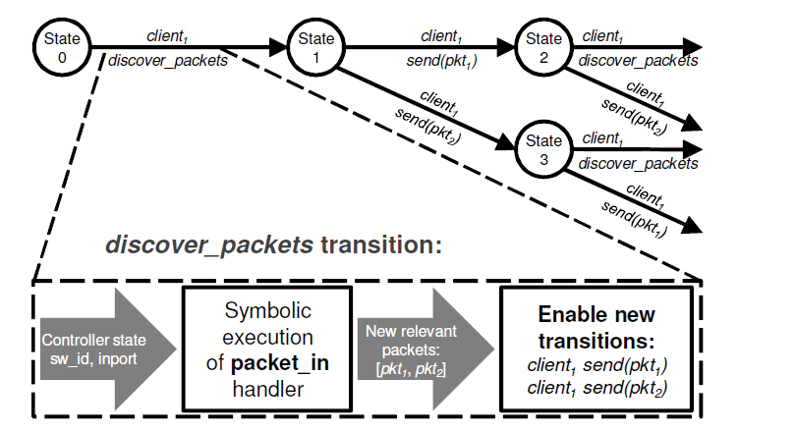
Combination
Notes:
(1) The state is the system state
(2) client means switch
(3) client sub i is the event that switch sub i got a packet_in
(4) discovery _packet is a wrapper handler for packet_in embedding symbolic execution: It knows the control state. The symbolic execution function does not. It simply tells it.
(5)Symbolic execution has branched outputs. Pkt1: client1 send to port Pkt2: client1 flood
(6) why the state has changed. Because mac table is updated
(7) every component state got the transition discover_packets, the combination of (client sub i , discover_packets) represent the system transition

Slide 20
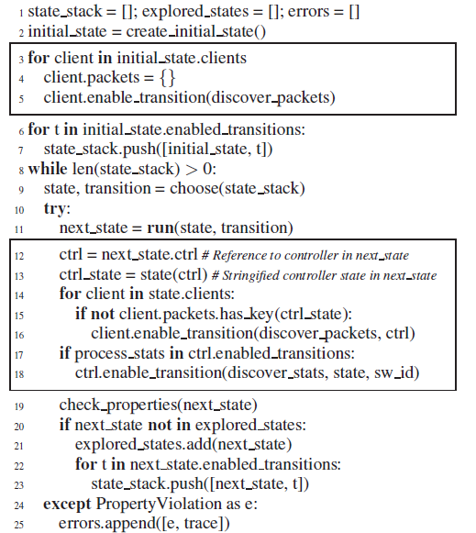
Initialization: enable discover_packets by every switch
Run discover_packets_transition and enable new transitions
Notes:
Second box will basically compute the next_state.enabled_transitions so that we can move on.
client.packets :hashtable: key is the state of the controller, value is the branch of the packets (struct)

Slide 21
Are you the switch in discover_packets_transition. If so, your next transition is already assigned. If not, continue listening on packets

Slide 22
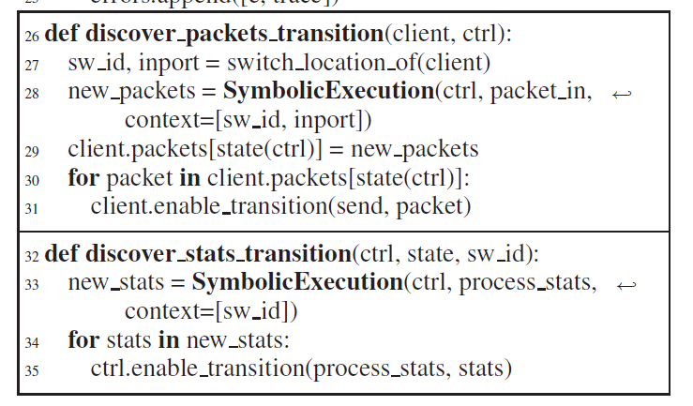
state of the ctrl is changed
Notes:
new_packets is a branch of packets to send (con1: pack1) (con2, pack2)

Slide 23
OpenFlow Specific Search Strategies
PKT-SEQ: Relevant packet sequences
NO-DELAY: Instantaneous rule updates
UNUSUAL: Uncommon delays and reordings
FLOW-IR: Flow independence reduction
PKT-SEQ is complementary to other strategies in that it only reduces the number of send transitions rather than the possible kind of event orderings

Slide 24
Specifying Application Correctness
Customizable correctness properties - testing correctness involves verifying that "something bad never happens" (safety) and that "something good eventually happens" (liveness).
To check these properties, NICE allows correctness properties to (i)access the system state, (ii) register callbacks, and (iii) maintain local state

Slide 25
Specifying Application Correctness
NICE provides a library of correctness properties applicable to a wide variety of OpenFlow applications.
Includes: NoForwardingLoops, NoBlackHoles, DirectPaths, StrictDirectPaths, NoForgottenPackets

Slide 26
Implementation
NICE consists of 3 parts:
A model checker - NICE remembers the sequence of transitions that created the state and restores it by replaying the sequence, state-matching is doing by comparing and storing hashes of the explored states.
A concolic execution engine - executes the Python code with concrete instead of symbolic inputs
A collection of models including the simplified switch and several end hosts.

Slide 27
Performance
The experiments are run on the topology of Figure 1 (reproduced here)
Host A sends a “layer-2 ping” packet to host B which replies with a packet to A.
The controller runs the MAC-learning switch program of Figure 3.
The numbers of transitions and unique states, and the execution time as the number of concurrent pings is increased (a pair of packets) are reported.

Slide 28
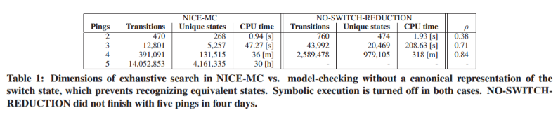
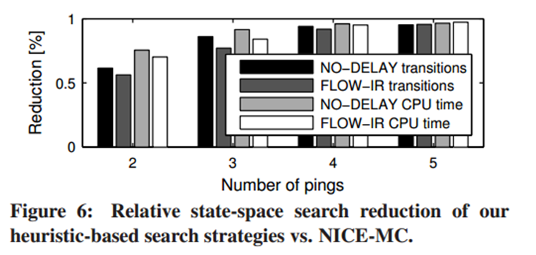
Performance

Slide 29
Performance
Comparison to state-of-the-art model checkers SPIN and JPF
SPIN performs a full search more efficiently, but state-space explosion occurs and SPIN runs out of memory with 7 pings
SPIN's Partial-order reduction only decreases the growth rate by 18%
JPF is already slower than nice, and even after extra effort is put into improving the Java model used in JPF, it is still substantially slower.

Slide 30
NICE and Real Applications
NICE detected 3 bugs in a MAC-learning switch (PySwitch)
Host unreachable after moving
Delayed direct path
Excess flooding

Slide 31
NICE and Real Applications
NICE found several bugs in a Web Server Load Balancer (dynamically reconfigures data center traffic based on load)
Next TCP packet always dropped after reconfiguration
Some TCP packets dropped after reconfiguration
ARP packets forgotten during address resolution
Duplicate SYN packets during transitions

Slide 32
NICE and Real Applications
Energy-Efficient Traffic Engineering (selectively powering down links and redirecting during light loads)
First packet of new flow is dropped
The first few packets of a new flow can be dropped
Only on-demand routes used under high loads
Packets can be dropped when the load reduces

Slide 33
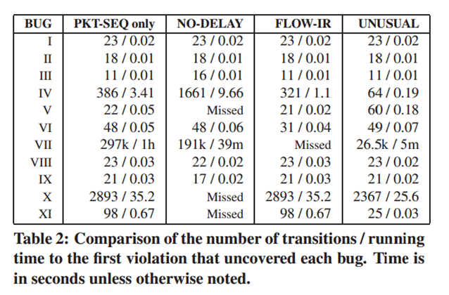
Overhead of running NICE

Slide 34
Coverage vs. Overhead Trade-Offs
There are some current limitations to NICE with the current approach
Concrete execution on the switch
Concrete global controller variables
Infinite execution trees in symbolic execution

Slide 35
Related work
NICE uses ideas in model checking and symbolic execution, and is the first to apply those techniques to testing OpenFlow networks.
Other work such as Frenetic, OFRewind, and FlowChecker can perform limited testing in OpenFlow networks.

